Slide 1
Logical Agents: Propositional Logic
Modus Ponens: Soundness and Completeness
Prof. Tarachand Amgoth

Slide 2

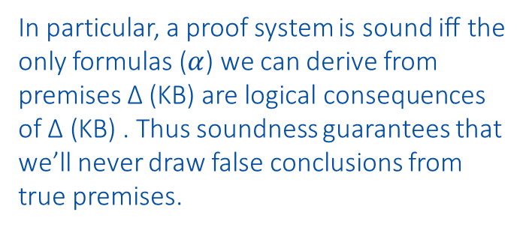
Modus Ponens
Modus Ponens is sound because if the premises P → Q and P are true, the conclusion Q must also be true.
KB⊢ $α$ implies that KB |= $α$
In particular, a proof system is sound iff the only formulas ($α$) we can derive from premises ∆ (KB) are logical consequences of ∆ (KB) . Thus soundness guarantees that we’ll never draw false conclusions from true premises.
Premise 1: If it rains, the ground will be wet (P → Q).
Premise 2: It is raining (P).
Conclusion: Therefore, the ground will be wet (Q).

Slide 3
Modus Ponens
Modus Ponens is sound because if the premises P → Q and P are true, the conclusion Q must also be true.
In this example, if both premises are true (i.e., it is actually raining, and rain makes the ground wet), then Modus Ponens guarantees that the conclusion Q (the ground is wet) must also be true.
This is why Modus Ponens is sound: it ensures that the conclusions derived from valid premises are also valid.
Premise 1: If it rains, the ground will be wet (P → Q).
Premise 2: It is raining (P).
Conclusion: Therefore, the ground will be wet (Q).

Slide 4
Inference Example
It is raining. (Rain)
If it is raining, then it is wet. (Rain → Wet)
Therefore, it is wet. (Wet)
Starting point:
KB={Rain, Rain → Wet, Wet → Slippery}
Apply modus ponens to Rain and Rain → Wet:
KB={Rain, Rain → Wet, Wet → Slippery, Wet}
Apply modus ponens to Wet and Wet → Slippery:
KB={Rain, Rain → Wet, Wet → Slippery, Wet, Slippery} Converged.
? Not Wet, Rain -> Slippery

Slide 5
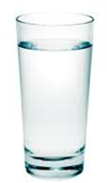

Soundness and Completeness
The truth, the whole truth, and nothing but the truth.
Soundness: nothing but the truth
Completeness: whole truth

Slide 6
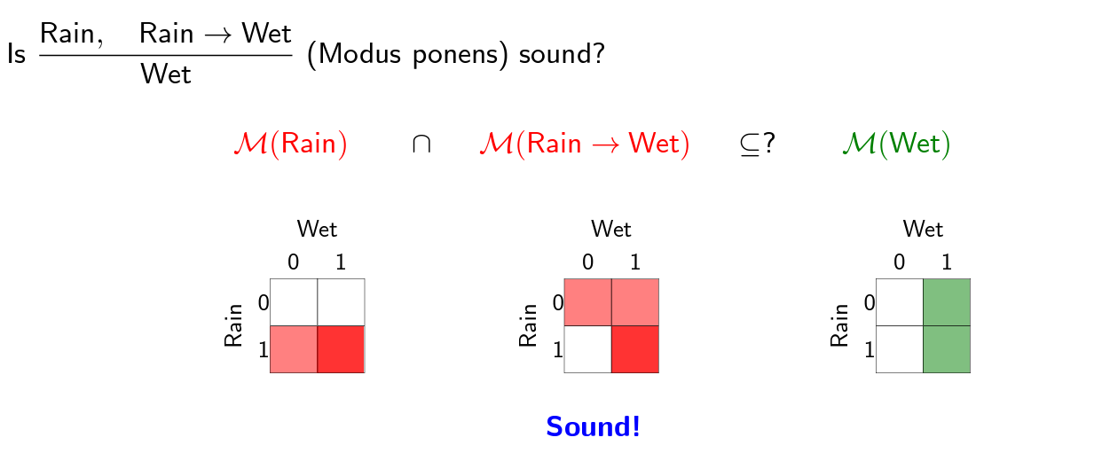
Soundness: Example

Slide 7
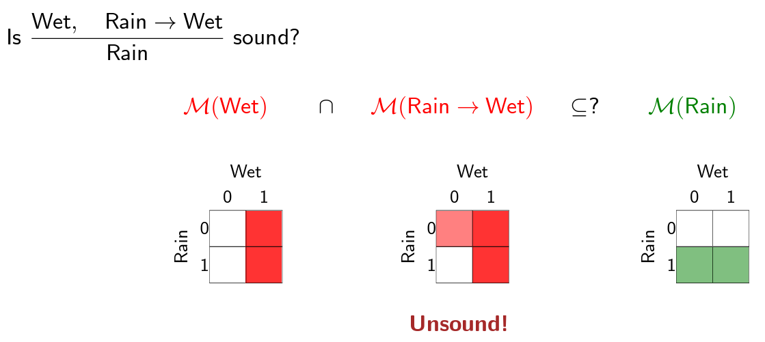
Soundness: Example

Slide 8
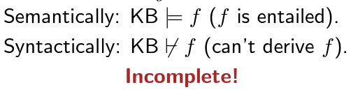
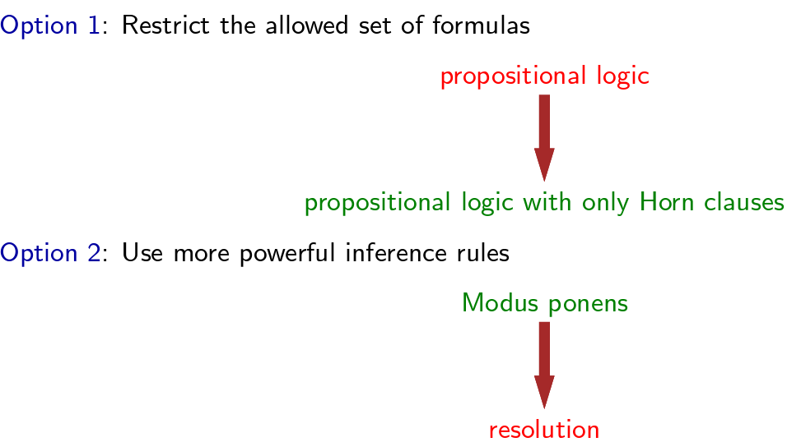
Fixing Completeness

